Slide 1
Introduction To Digital Identity
Alex Melville
5F11 78CD D43A 49E9 10D6 D27C 773A E36E 3704 569C

Slide 2
Intro
Current Digital Identities
PGP
Cryptography Basics
Blockchain Identity
Let’s Make Some Keys

Slide 3

Alex Melville
Software Engineer
@ BitGo
github.com/Melvillian

Slide 4
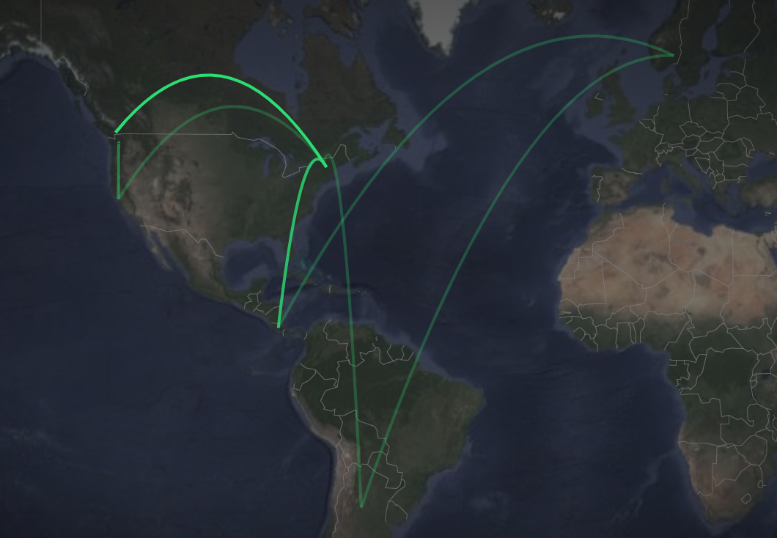
Alex Melville
Digital Nomad

Slide 5
Audience Poll!
What is identity?

Slide 6
Audience Poll!
What is identity?
Something you know, something you have, something you are

Slide 7
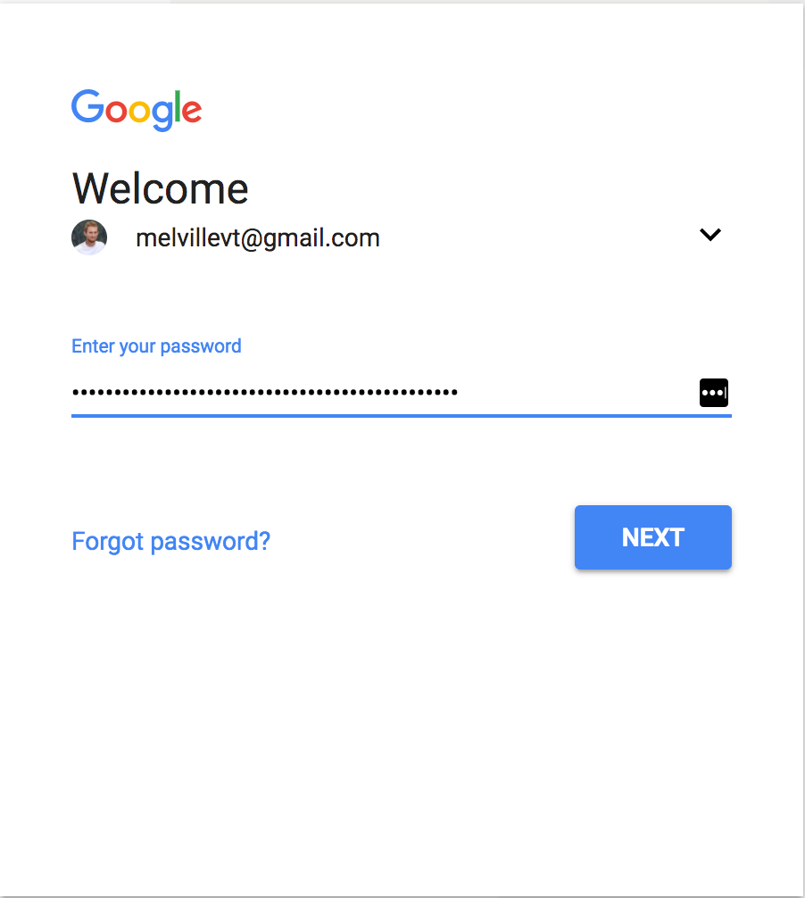
Commonly Used Digital Identities
Web Accounts
200+ accounts
Lightweight
Non-transferable

Slide 8
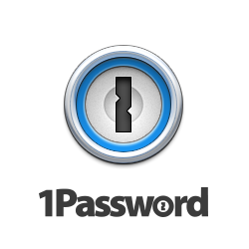



Commonly Used Digital Identities
Web Accounts
200+ accounts
Lightweight
Non-transferable
Need a Password Manager

Slide 9
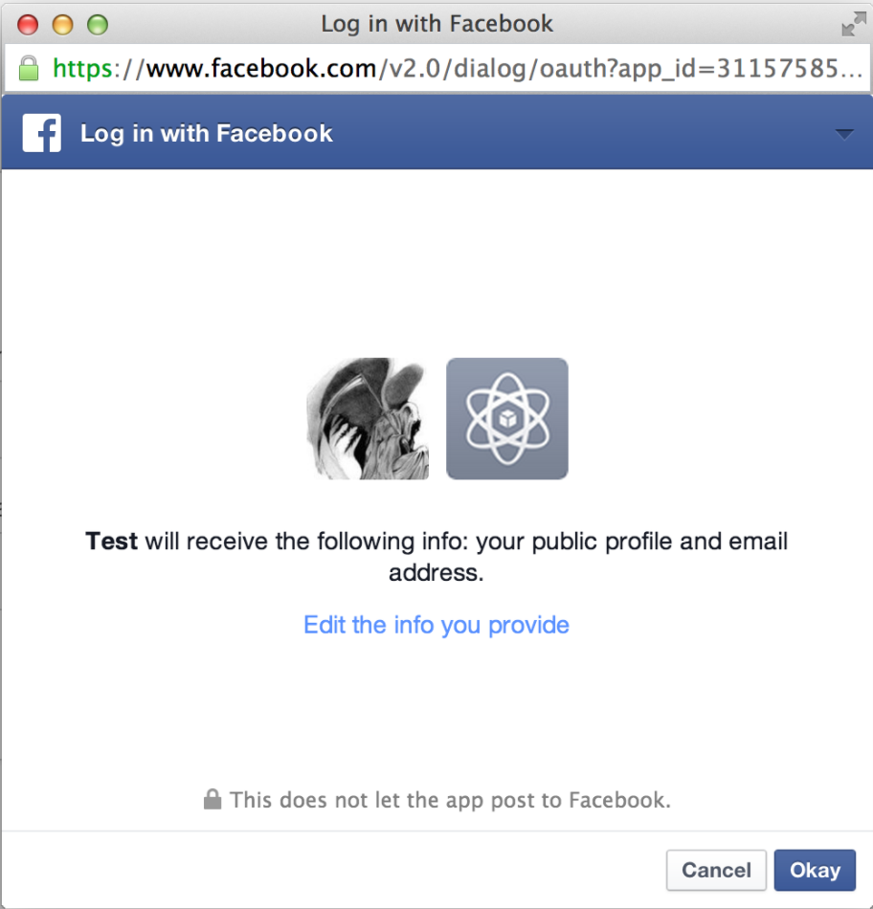
Commonly Used Digital Identities
OAuth
Facebook
Twitter
Google
Username + Password (+ 2FA)

Slide 10

Commonly Used Digital Identities
Social Insurance Numbers :(
Identification AND Authentication

Slide 11
PGP (Pretty Good Privacy)
“PGP is used for signing, encrypting, and decrypting texts, e-mails, files, directories, and whole disk partitions and to increase the security of e-mail communications.”
-Wikipedia

Slide 12
PGP (Pretty Good Privacy)
Created by Phil Zimmermann in 1991
By PRZ_closeup.jpg: User Matt Crypto on en.wikipediaderivative work: Beao - PRZ_closeup.jpg, CC BY-SA 3.0, https://commons.wikimedia.org/w/index.php?curid=9009023

Slide 13

PGP (Pretty Good Privacy)
Created by Phil Zimmermann in 1991
By PRZ_closeup.jpg: User Matt Crypto on en.wikipediaderivative work: Beao - PRZ_closeup.jpg, CC BY-SA 3.0, https://commons.wikimedia.org/w/index.php?curid=9009023

Slide 14
PGP (Pretty Good Privacy)
Decentralized Web of Trust
2. Public/Private Key Cryptography

Slide 15
PGP (Pretty Good Privacy)
Bob

Slide 16
PGP (Pretty Good Privacy)
Alice
Bob

Slide 17
PGP (Pretty Good Privacy)
Alice
Bob
Fatima

Slide 18
PGP (Pretty Good Privacy)
Alice
Bob
Lea
Fatima

Slide 19
PGP (Pretty Good Privacy)
Alice
Bob
Lea
Nick
Fatima

Slide 20
PGP (Pretty Good Privacy)
Alice
Bob
Lea
Nick
Fatima

Slide 21
PGP (Pretty Good Privacy)
Alice
Bob
Lea
Nick
Fatima
= single trust line
= triple trust line

Slide 22
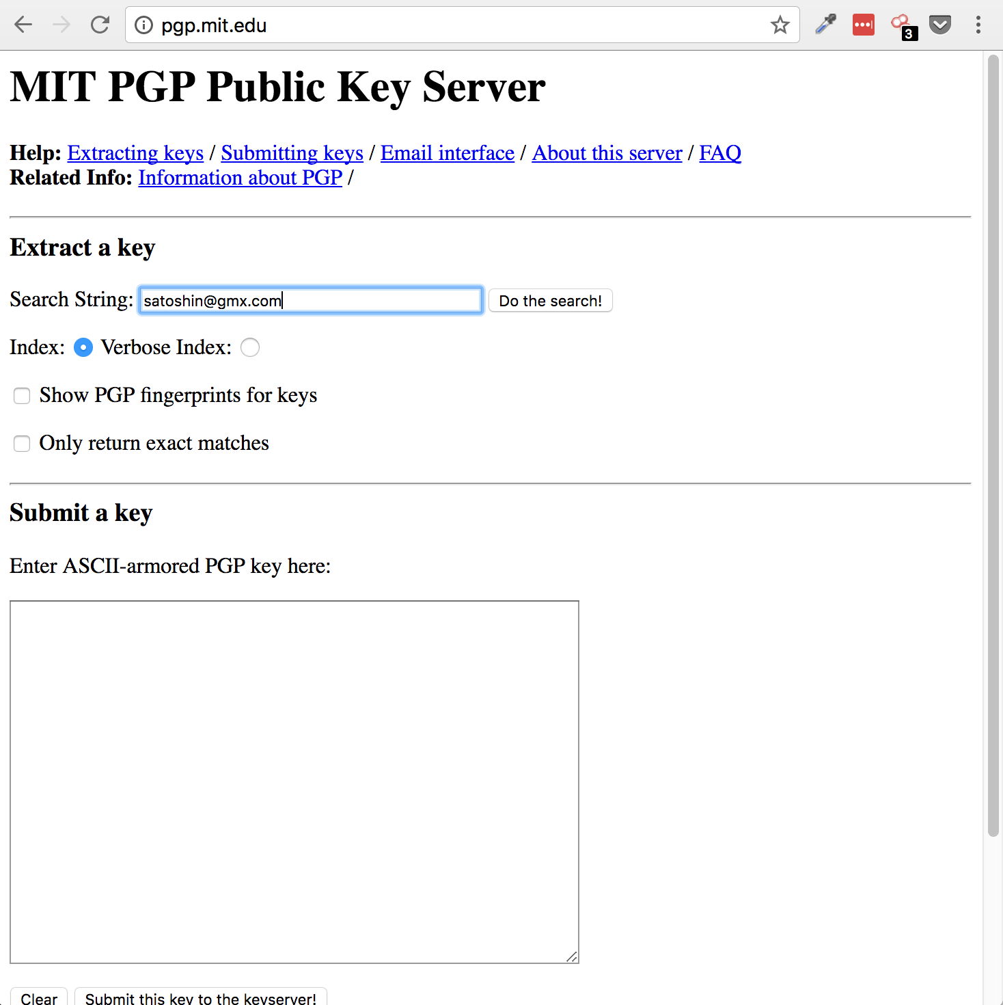
PGP (Pretty Good Privacy)
Public Keyservers

Slide 23
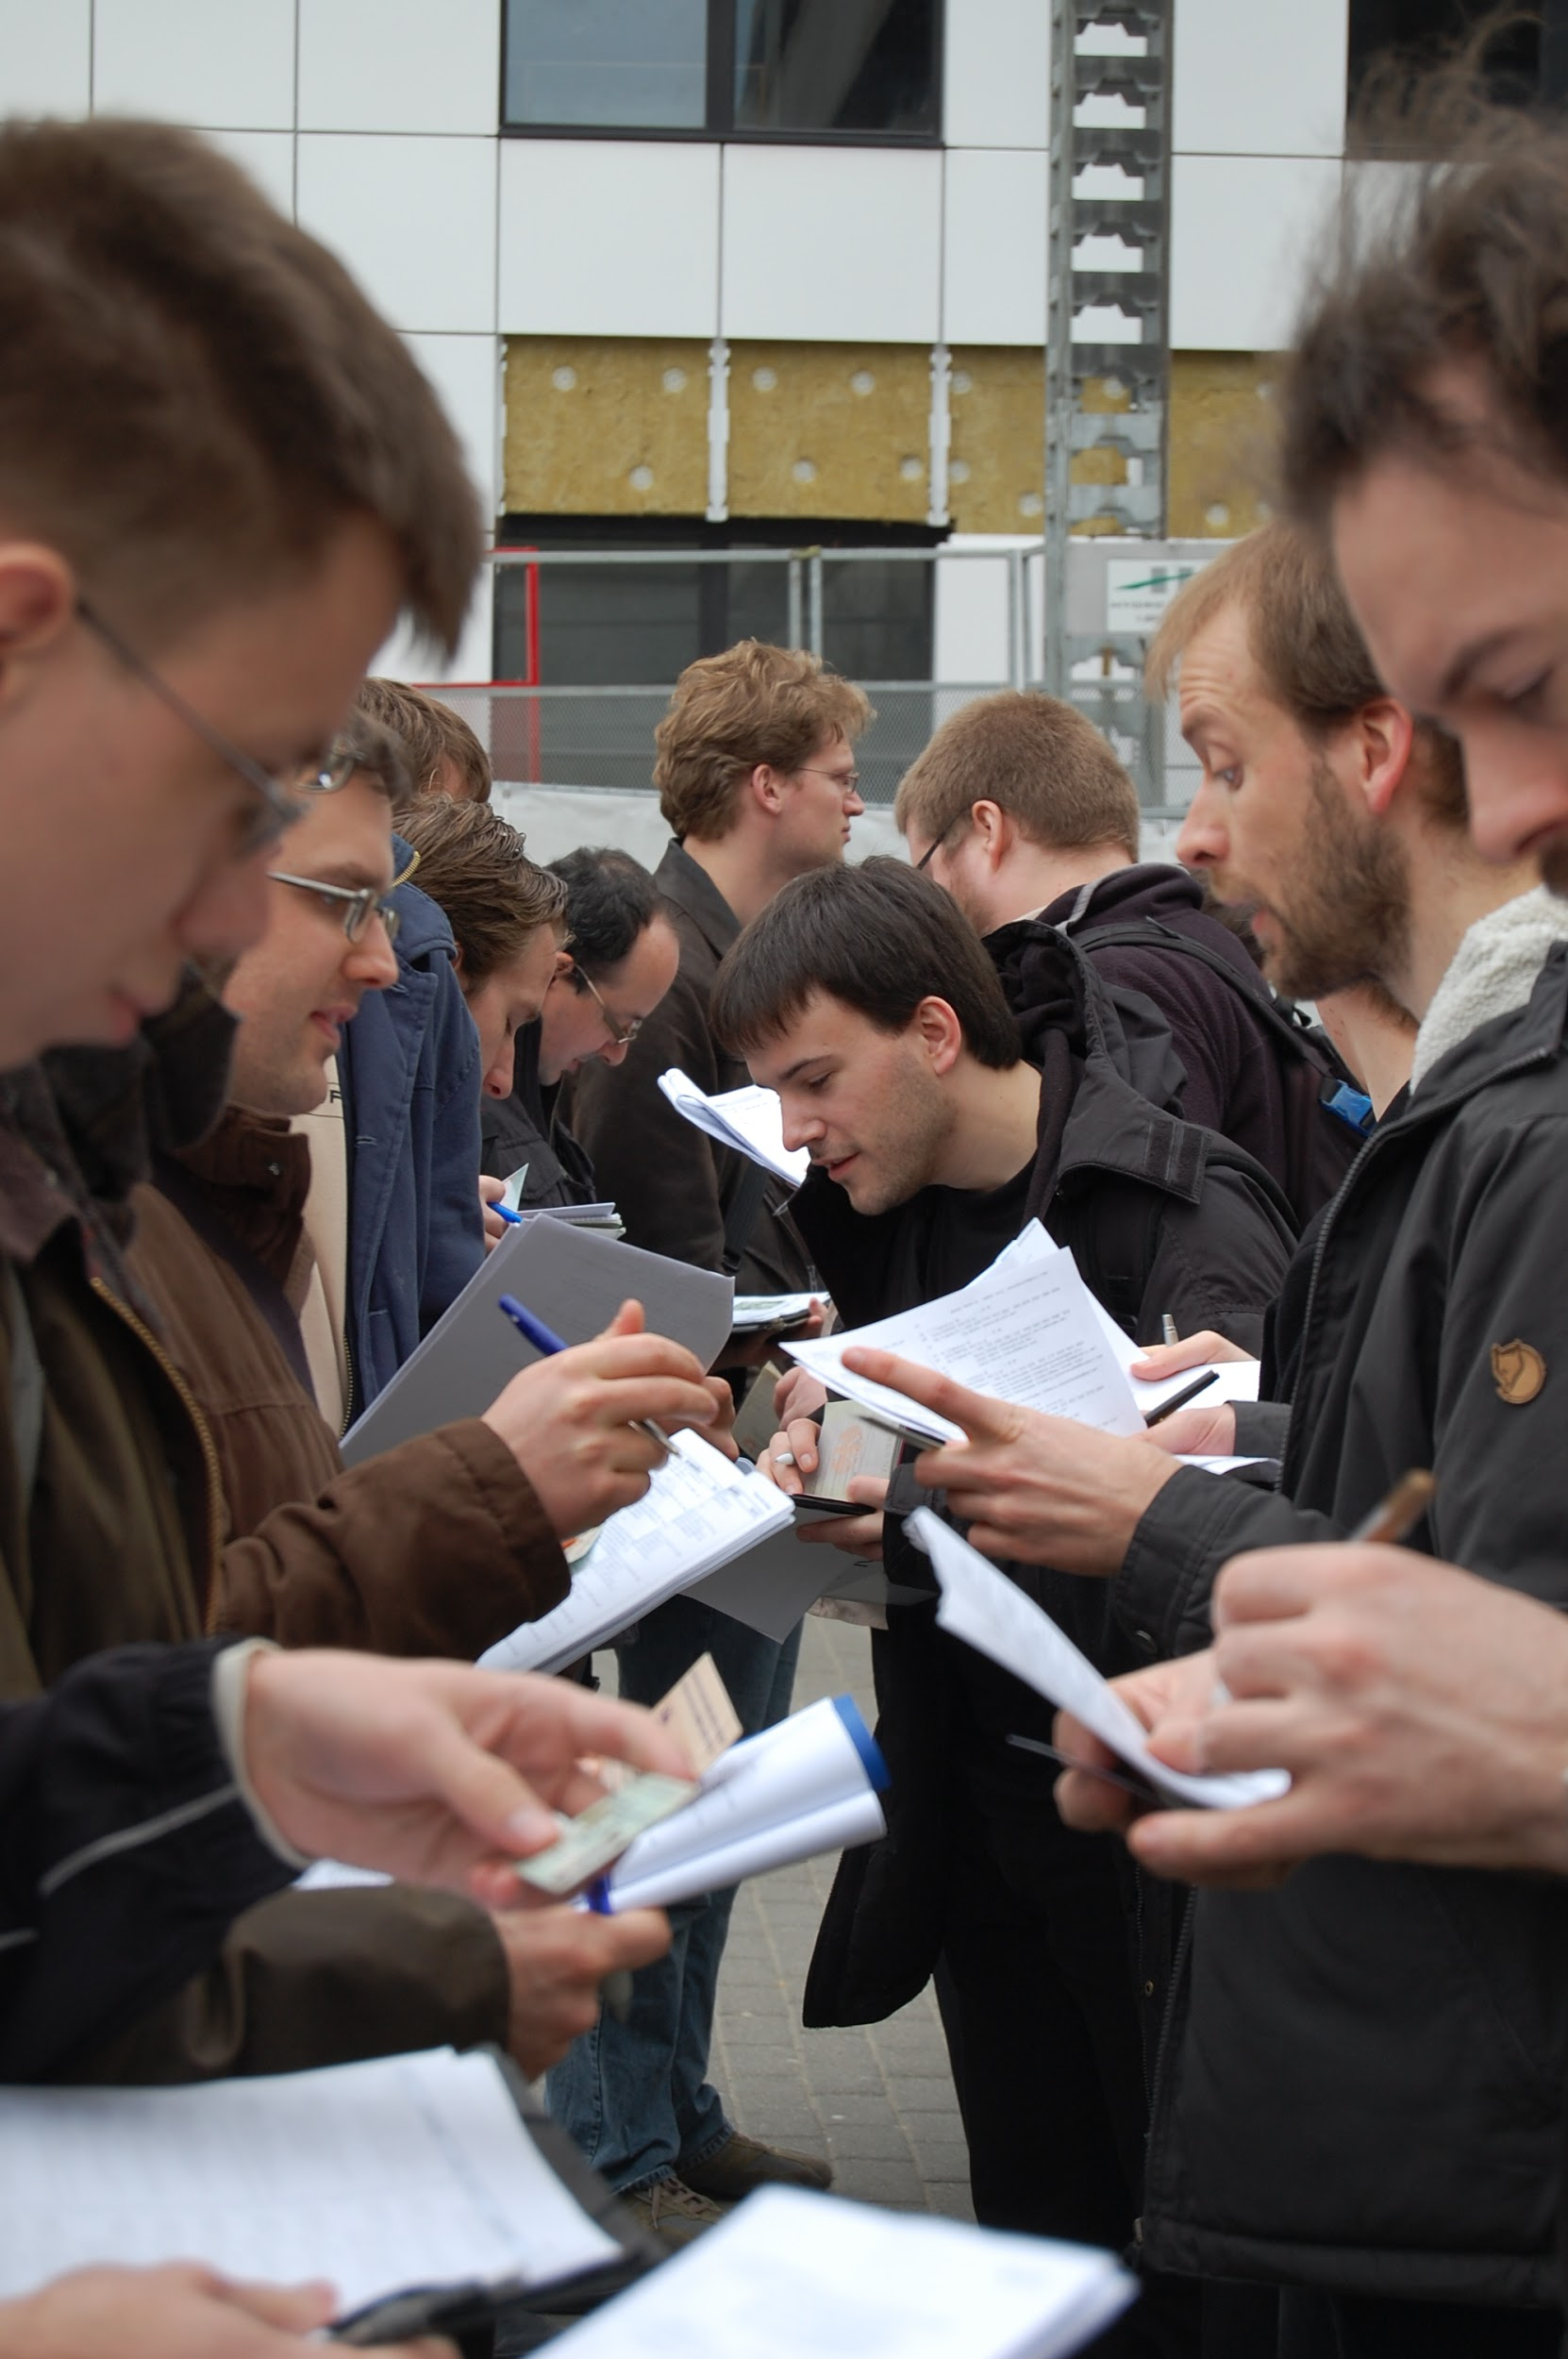
PGP (Pretty Good Privacy)
Key Signing Parties

Slide 24
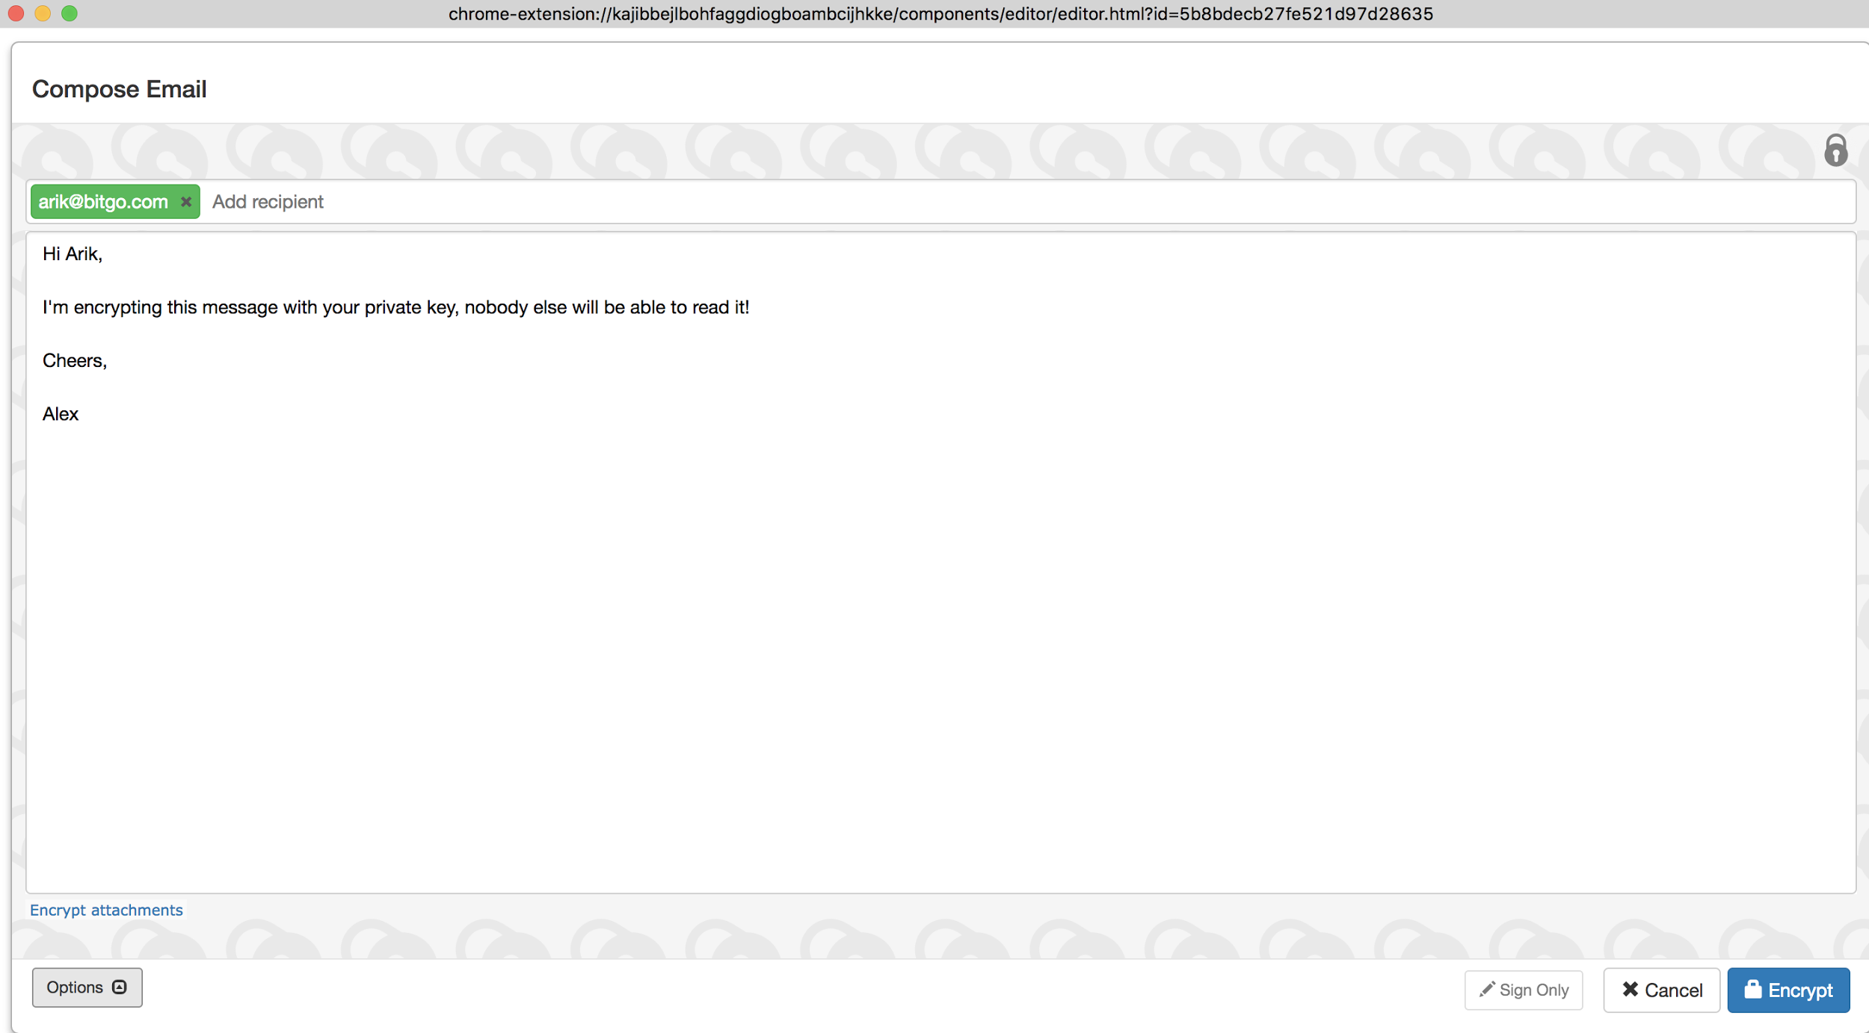
PGP (Pretty Good Privacy) Encrypting with Mailvelope

Slide 25
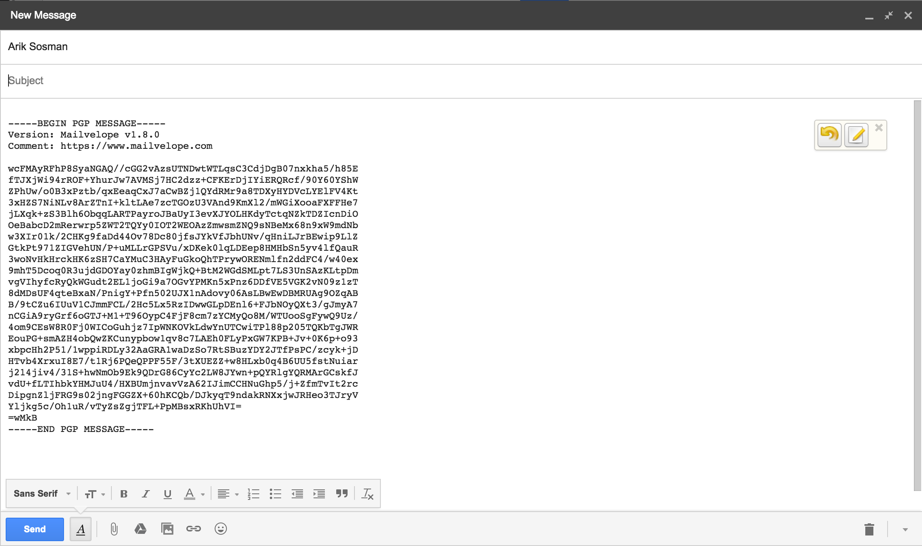
PGP (Pretty Good Privacy) Encrypting with Mailvelope

Slide 26
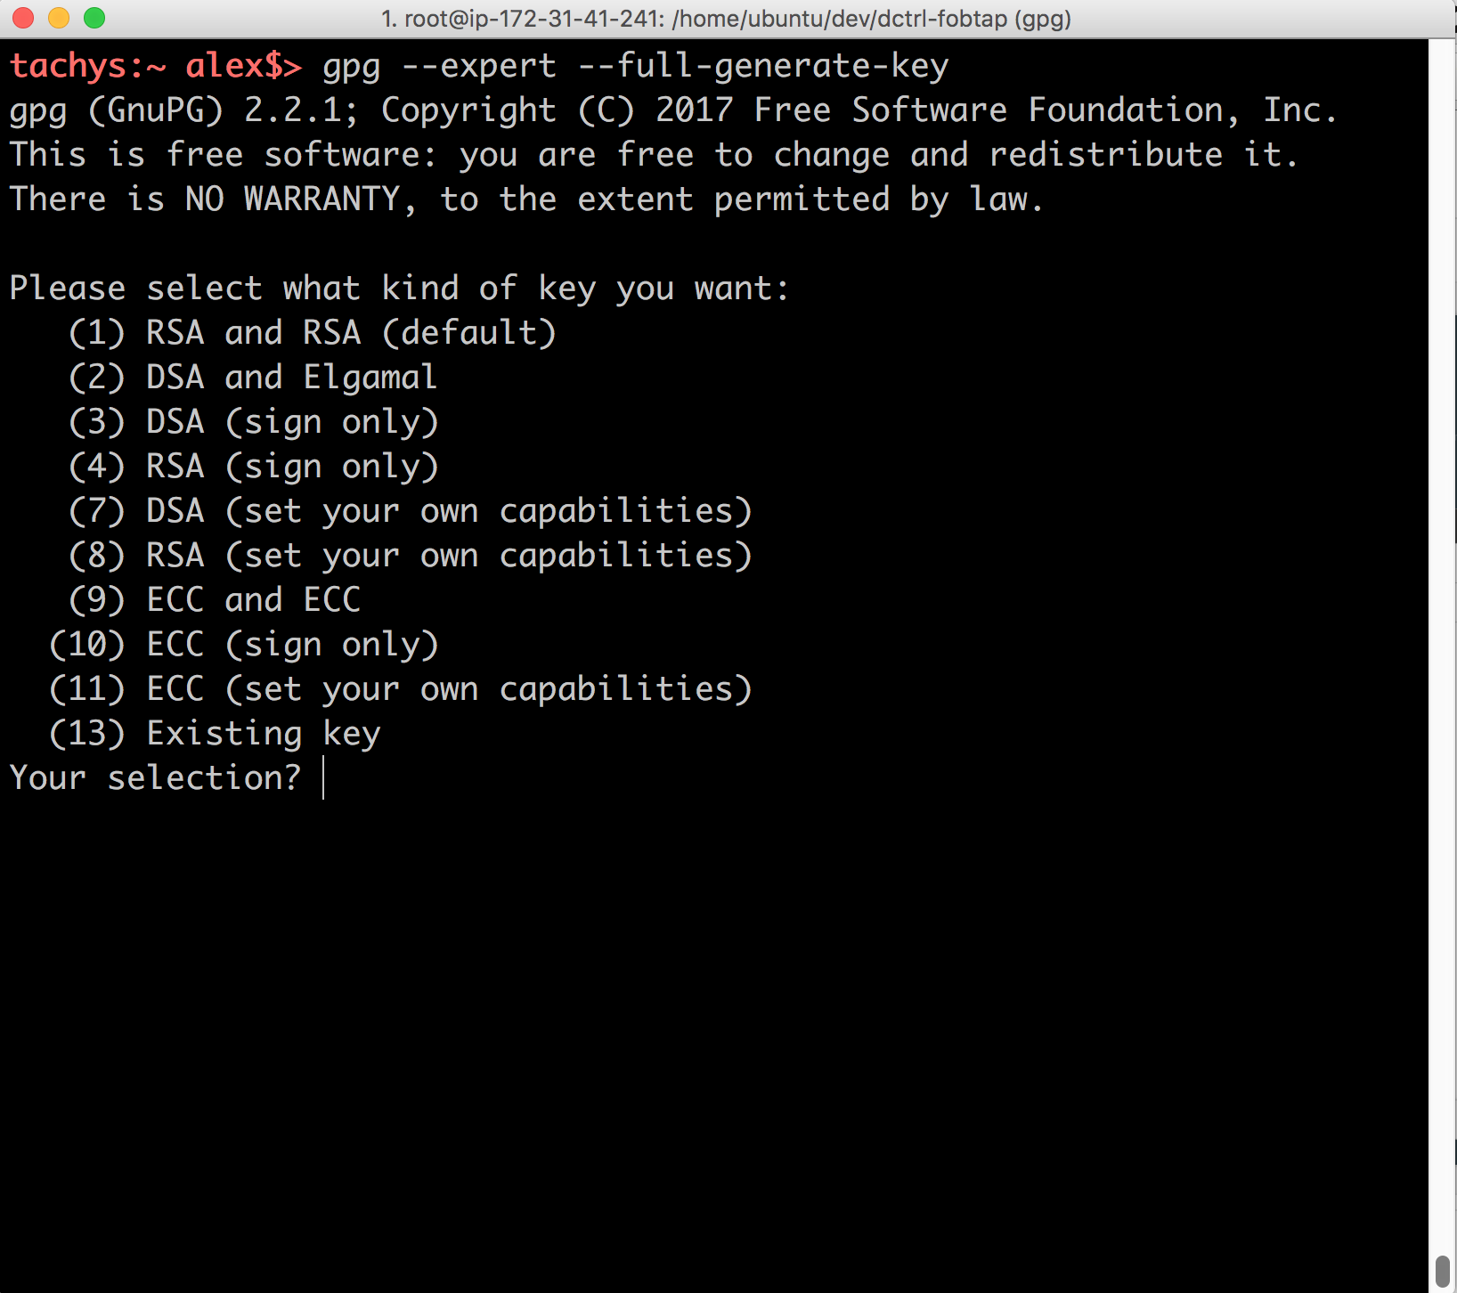
PGP (Pretty Good Privacy)
Command Line PGP
with GNU Privacy Guard (gpg)

Slide 27
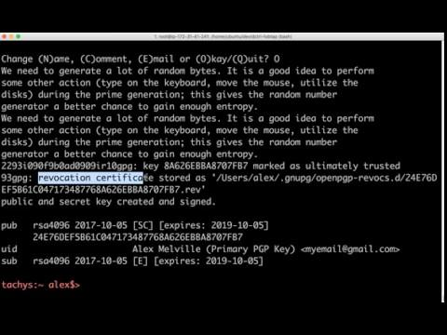
PGP (Pretty Good Privacy) Key Creation

Slide 28
PGP (Pretty Good Privacy) Signing

Slide 29
Cryptography Basics
Why Use it?
Encryption
Secure Messaging (Whatsapp)
Digital Signatures
Used for authenticating (git signing)

Slide 30
Cryptography Basics
Two Main Types
Symmetric
Only 1 key
AES is most common
Fast
Asymmetric (public/private)
2 keys
DSA is most common
Slow

Slide 31
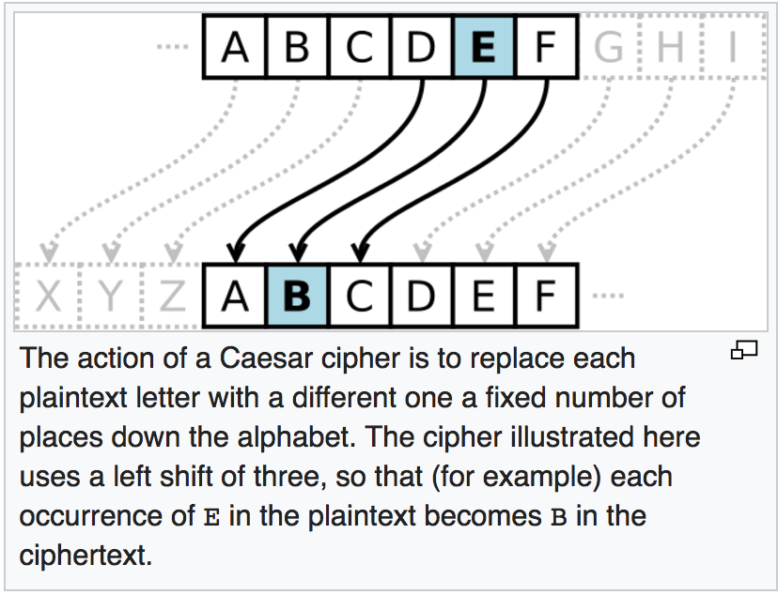
Cryptography Basics
Symmetric: Caesar Shift Cipher
abcd → bcde
wxyz → xyza

Slide 32
Cryptography Basics
Toy Example!
Do Not Use At Home

Slide 33
Cryptography Basics
Public/Private Key
Cryptography

Slide 34
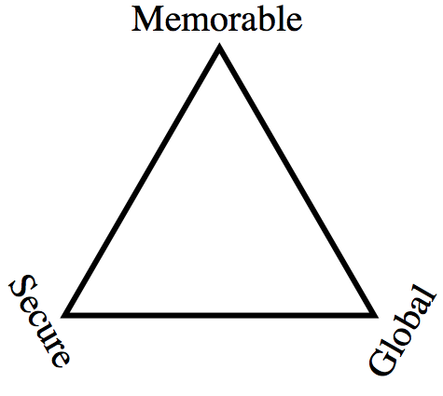
Identity on the Blockchain
Zooko’s Triangle

Slide 35
Identity on the Blockchain
Zooko’s Triangle
Bitcoin

Slide 36
Identity on the Blockchain
Embed identity information in blockchain (bitcoin) transactions

Slide 37
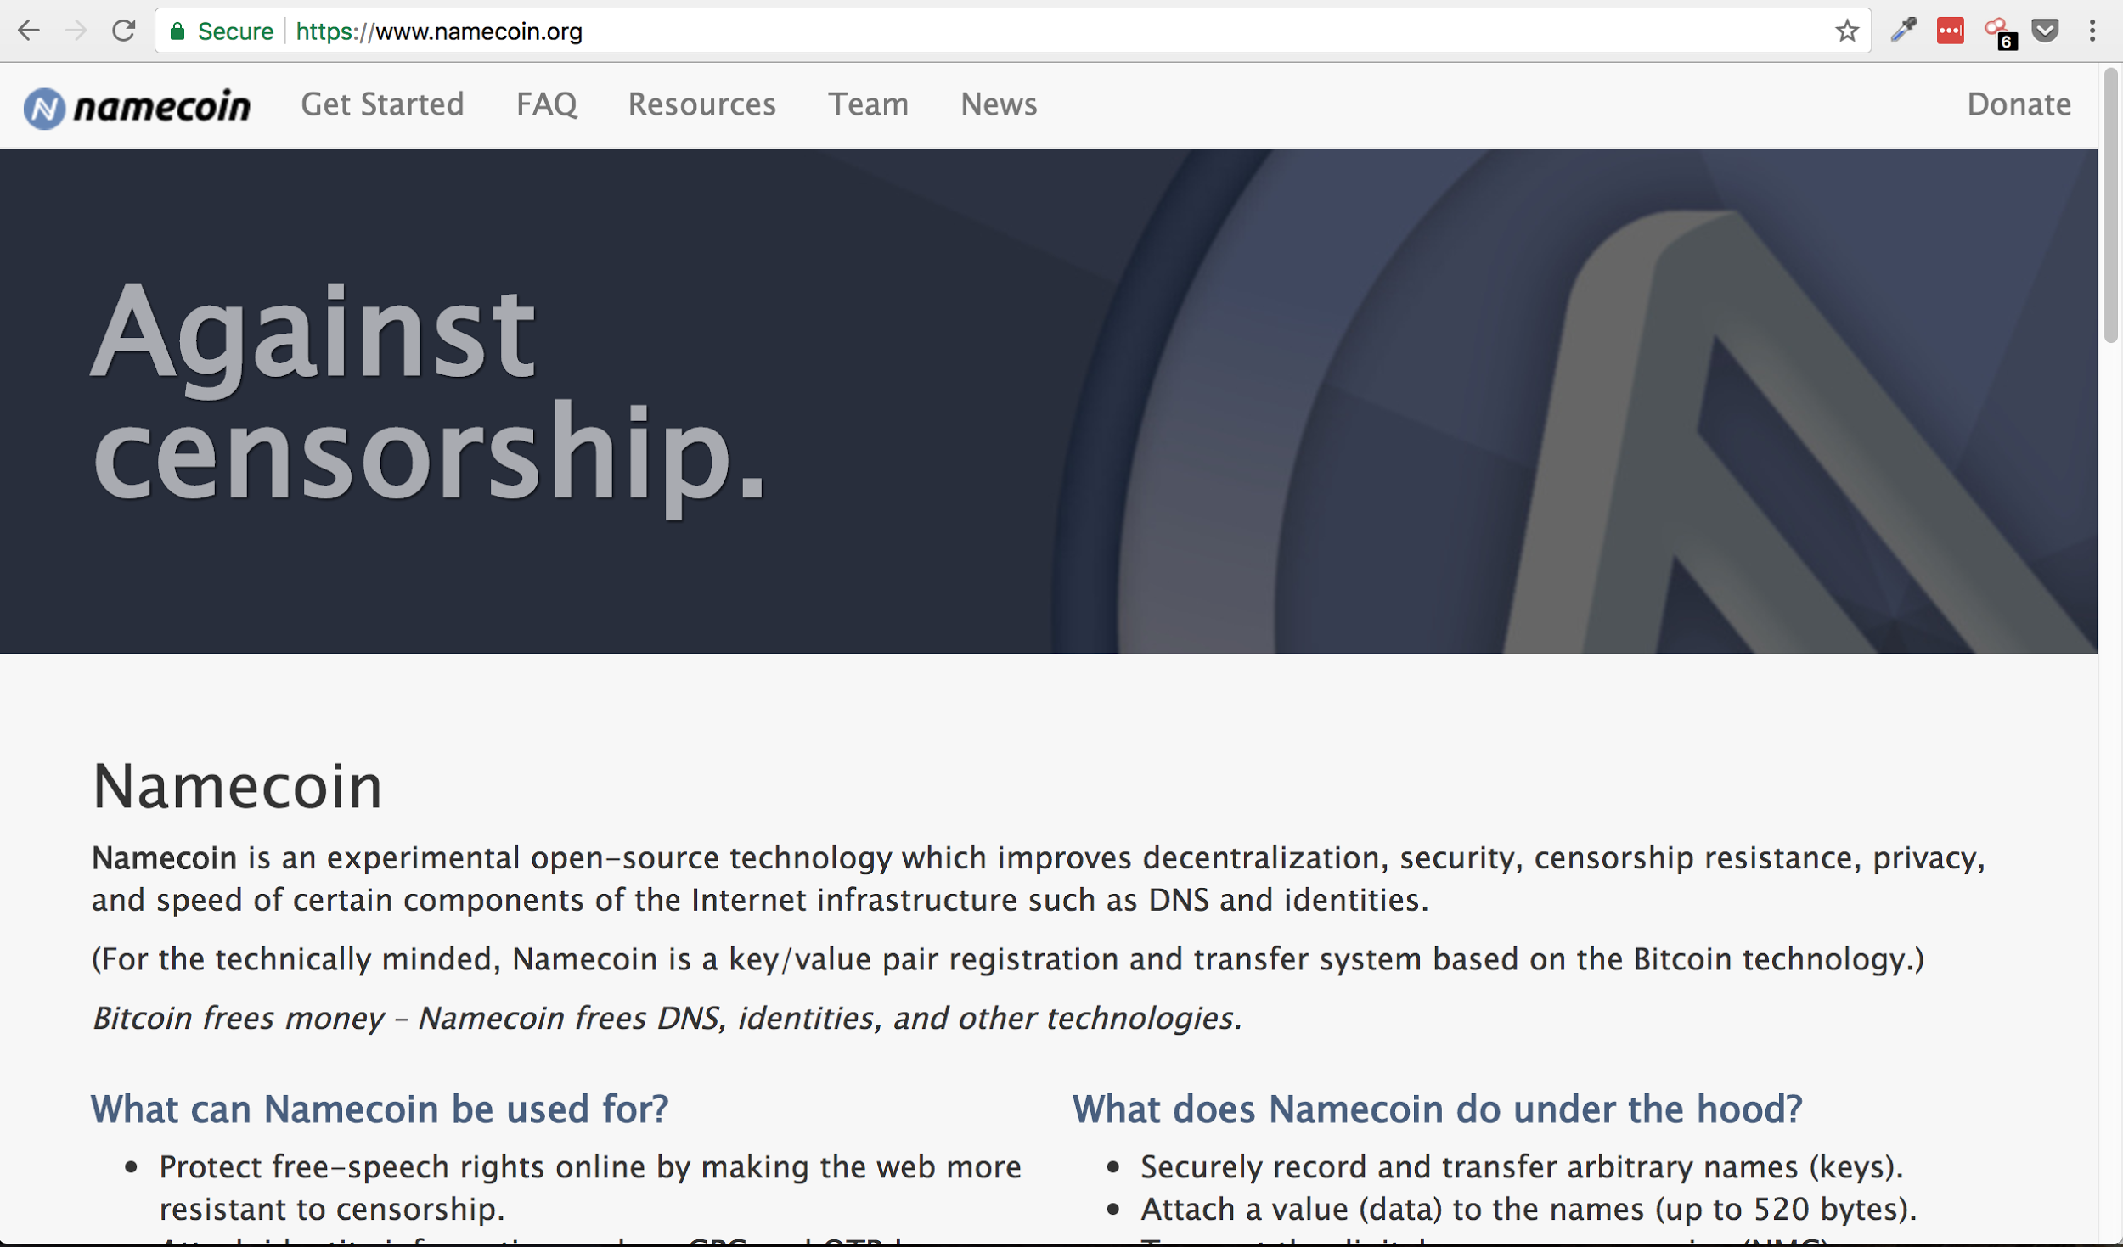

Slide 38
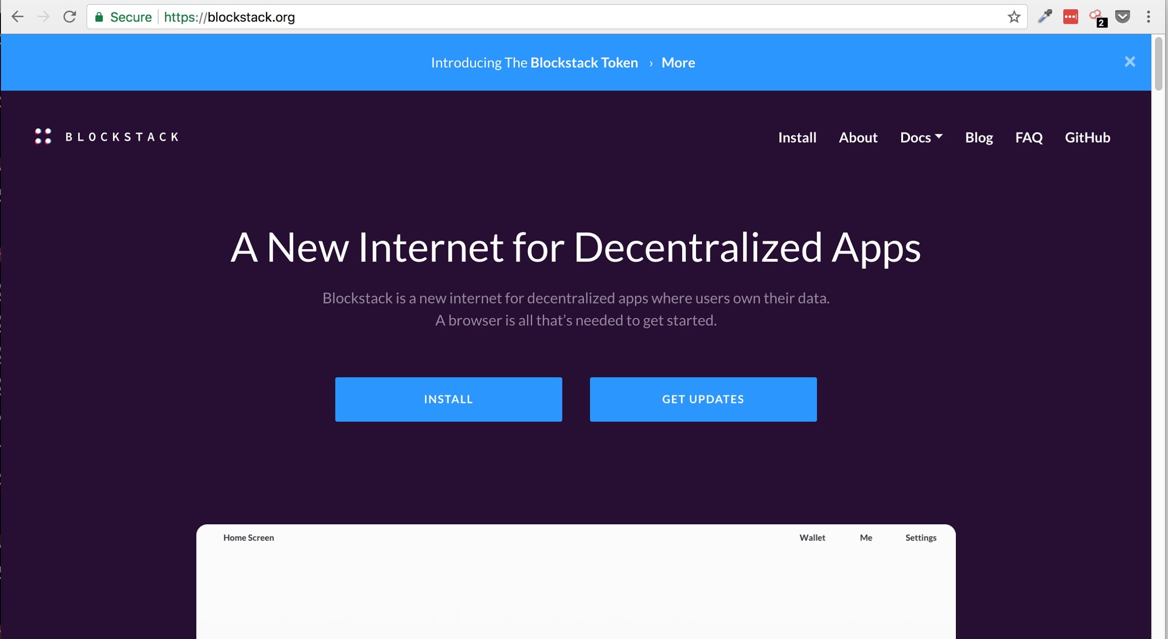

Slide 39
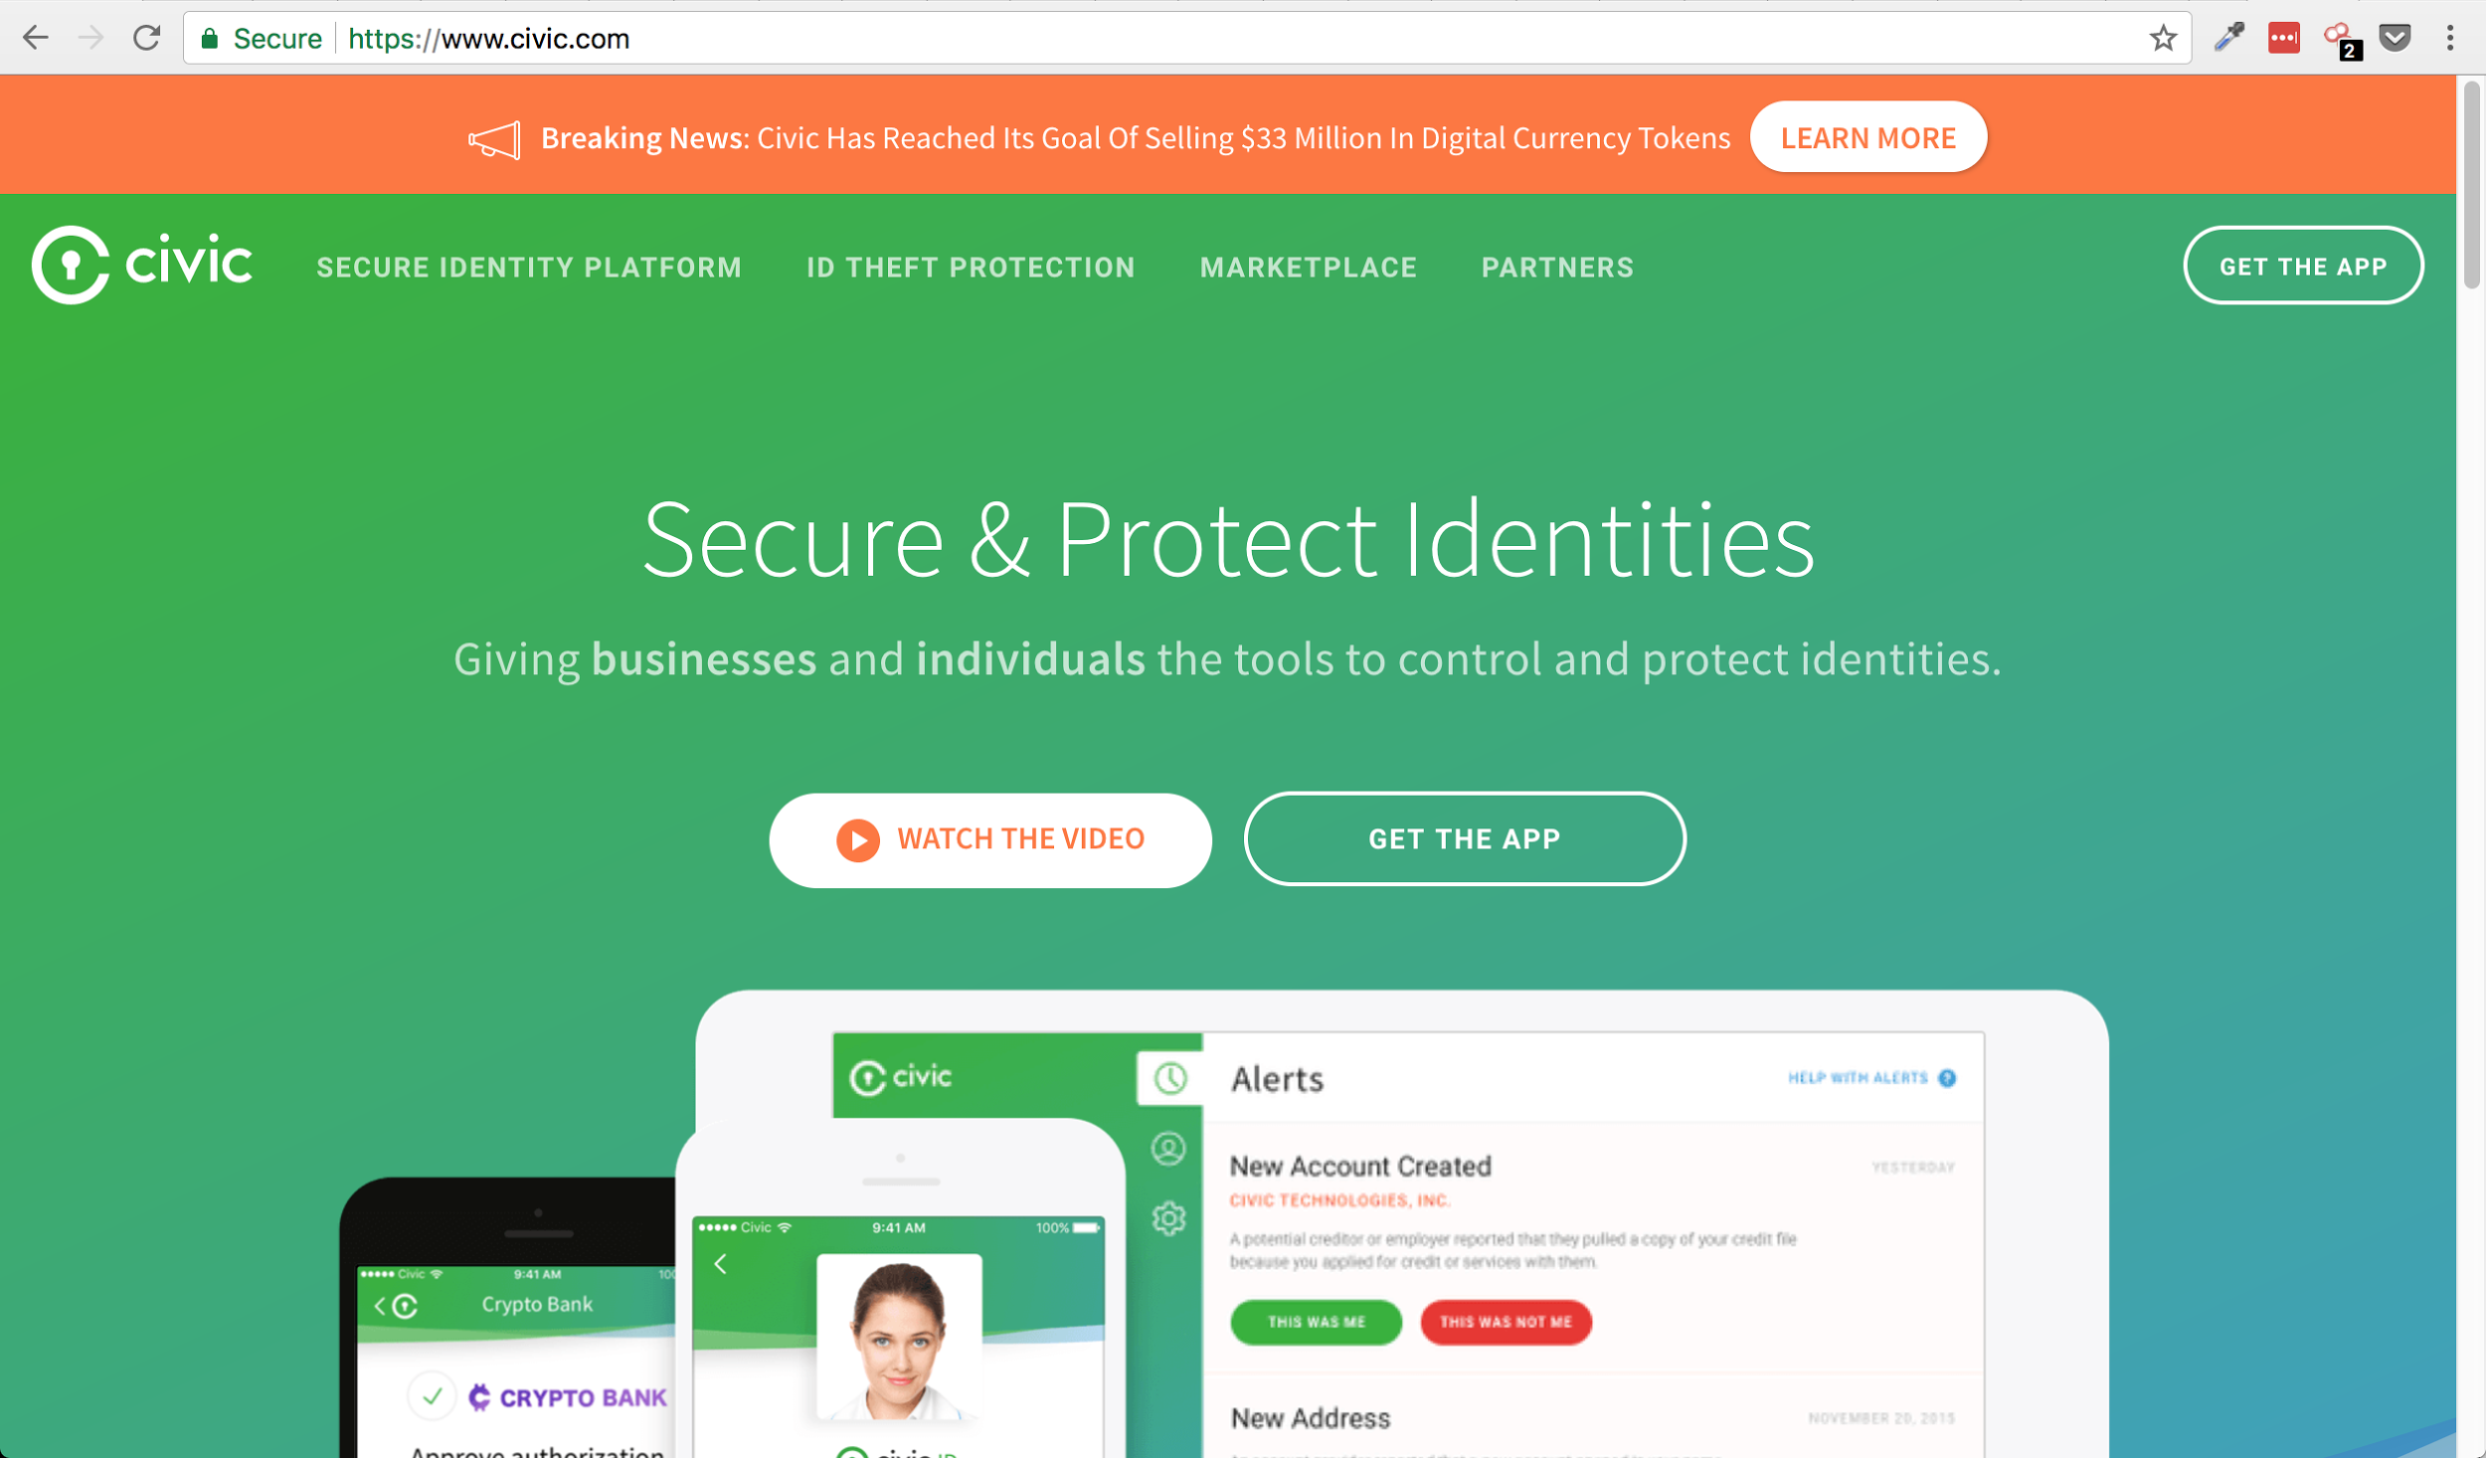

Slide 40
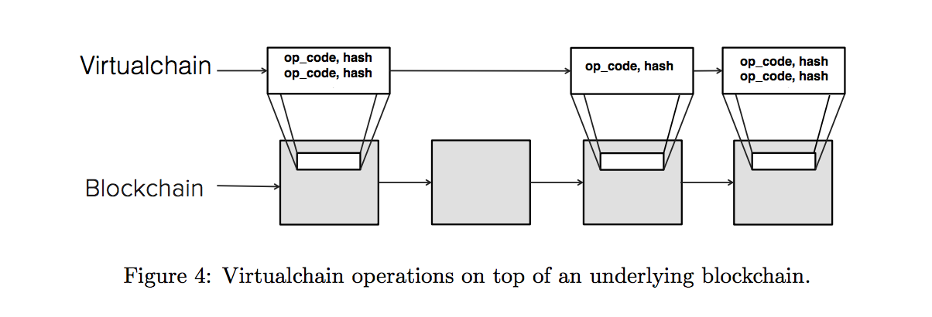

Slide 41
Public PGP Keyserver ←→ Blockchain

Slide 42
Recap
Current Digital Identities
PGP
Cryptography Basics
Blockchain Identity
Create Your Own Identity Walkthrough (if there’s time!)

Slide 43
Questions…?
...80fb
...3b2c
...c584

Slide 44
More PGP Resources
https://github.com/Melvillian/gpg_tutorials
https://en.wikipedia.org/wiki/Pretty_Good_Privacy
https://www.gnupg.org/documentation/manuals/gnupg/Operational-GPG-Commands.html
https://spin.atomicobject.com/2013/11/24/secure-gpg-keys-guide/
https://malcolmsparks.com/posts/yubikey-gpg.html
https://steemit.com/security/@the-tech-guy/how-to-configure-your-yubikey-for-use-with-gnupg
https://getpocket.com/a/read/1914461520
https://developers.yubico.com/PGP/Card_edit.html

